Slide 1
International Harmonization of the “Training of Trainers” Program of Community Health and Social Services for Older Persons
Toyota Foundation 26 Feb.-1 March, 2017, Seoul
Sharing Responses on the Ground:
Aging Society and the Surrounding Challenges in Asia
Takeo Ogawa, Ph.D.
President, (NPO)Asian Aging Business Center
Emeritus Professor, Kyushu University
Notes:
It is my honor to present my project in this symposium.
I am Takeo Ogawa. I have a founder of Active Aging Consortium in Asia Pacific. It is called as ACAP. This project was proceeded by our fellow of ACAP.

Slide 2
From Demographic Bonus to Onus in Asia: Changing Dependency Ratio
World Population Prospects: 2015 revision. Total Dependency Ratio.
Notes:
We, Asian countries, are changing form demographic bonus era to demographic onus era. If curve is falling to the right, it will be favorable for economic growth. Then, its trend will be called as “Demographic Bonus” or “Demographic Gift.” But, if it is in the opposite direction, it will be disadvantage for economic growth. Then, it will be called as “Demographic Onus.” Japan has turned from demographic bonus to onus in 1995. And almost Asian countries will follow to Japanese track. In such social situation, not only older persons but also working-age generation will be confronted with difficulties. Therefore, we should focus on the labor productivity of long-term care workers and caregivers through capacity building.

Slide 3
Issues
Obstacle of “Aging in Place”
For Physical, Mental & Social
Well-being for the Older Persons
Over-dependent
Hospitalization
Over -dependent
Institutionalization
Insufficient Integrated Community Care
Hospital-based Professionals
Galapagosization
of Care Work
Decline of Community & Family Support
Deficits of Community-based Health Care
Deficits of
Community-based
Long-term Care
Deficits of
Community Reorganization
Insufficient Capacity Building of Health & Social Services for Older Persons
Notes:
Why do we challenge such issues as international harmonization of the training of trainers program ? This is a chart of issue analysis. A yellow box is a problem to be solved.
Although older persons wish to be aging in place, they cannot keep their everyday activities in home and in community by themselves, because of insufficient integrated community care, and they might be hospitalized or institutionalized.
Insufficient integrated community care is caused by the decline of community and family support. Community reorganization does not proceed yet. Then older persons and their families tend to depend on hospitalization and institutionalization reluctantly.
According to the trend, care workers are trained as professionals and wage-workers for engaging in hospitals and long-term care facilities.
Especially, as long-term care workers are qualified by each country, they cannot migrate internationally with universal certification of their competence. The situation will be called as Garapagosization, which means the required skill and knowledge is adaptable only domestically, and it cannot applicable internationally.
Also, these professionals and wage workers are not trained as community-based workers. Furthermore, Family care Givers and Community care givers are not supported by these professionals and wage workers so well.
In summary, we are insufficient for capacity building of Health and Social Services for older persons to be realize “aging in place.”

Slide 4
Teleological Agenda
Realizing “Aging in Place”
For Physical, Mental & Social
Well-being for the Older Persons
De-hospitalization
De-institutionalization
Enhancing Integrated Community Care
Holistic Care Professionals
Harmonization
of Care Work
Awareness of Community & Family Support
Organization of Community-based Health Care
Organization of
Community-based
Long-term Care
Designing of
Community Reorganization
International Open Innovation for Harmonizing Community Health and Social Services of Older Persons
Notes:
In order to realize “Aging in Place,” we will make effort to mind set or paradigm shift of health and social services.
Medical professionals should make effort to establish holistic care and organize community-based health care. Their basic competence is universal one already. However, if they engage in community-based care, it will have to be customized to a community.
Care workers in long-term care facilities should make effort to harmonize their knowledge and skills with other countries, because long-term care is a concept regarding on quality of life particularly. Under the integrated community care system, they will have to be trained more than the present situation.
Furthermore, neighborhood community should be recognized for enhancing integrated community care. Family care givers an d community volunteers are trained as knowledgeable and skillful resources for realizing “Aging in Place.” And each community should be designed as an age-friendly and healthy community.
In summary, we need to understand particularistic community needs to live and universal knowledge and skills for providing health and social services, and we should make effort to harmonize them. It is an international open innovation of community health and social services for older persons.

Slide 5
Starting Year of Aging and Its Speed
PHILIPPINES
INDONESIA
MYANMAR
MALAYSIA
VIETNAM
SINGAPORE
THAILAND
CHINA
Arrived Year to 7% of Age 65+ Ratio
KOREA
Years
Number of Years from 7% to 14% of Age 65+ Ratio
Data Source: World Population Prospects: 2015 revision.
Notes:
Then, we will have to find counterpart in Asian countries for clarifying our aging situation.
The vertical axis is the starting year of aging. And, the horizontal axis is a speed of population aging from 7% to 14 %, doubling of 65+ population ratio.
Then, we choose Korea and Indonesia for comparison with Japan.

Slide 6
Two Strategies of Harmonization
JAPAN
Super Aged Society
Developed country which has problems of aging and various
precedential practices.
Mutual Authentication
CHINA, THILAND, SINGAPORE, and KOREA
Aging Society
Rapid aging countries which will follow to aging Japan.
About 3 decades
time-lag
Active Learning of
Long-term Care
About 2 decades time-lag
VIETNAM, INDONESIA, and MYANMAR
Pre-Aging Society
Still younger countries which will follow to aging Asia
Notes:
Among our counterparts, we will make two strategies of harmonization.
One strategy is mutual authentication of training and certification between Japan and Korea.
Although the mutual authentication is difficult, Korean students, which graduated and passed the long-term care national exam, will be employed as same as Japanese in long-term facilities. For their career path, the ToT program will be required I near future.
Another strategy is the brain circulation of long-term care between Japan and Indonesia. Nowadays, Japan is inviting candidates of Japan Certificated Care Workers from Indonesia. Also, technical intern of long-term will be invited into Japan. Therefore, we need to assess the knowledge and skills of long-term care for transferring from Japan to Indonesia. It needs for Indonesian Certified Care Workers to be trained as trainers of technical intern.

Slide 7
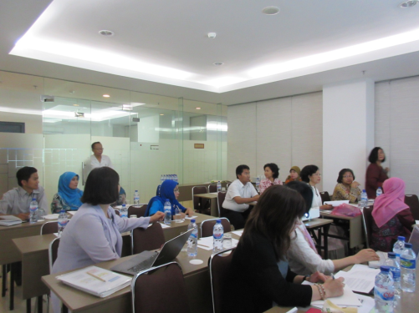
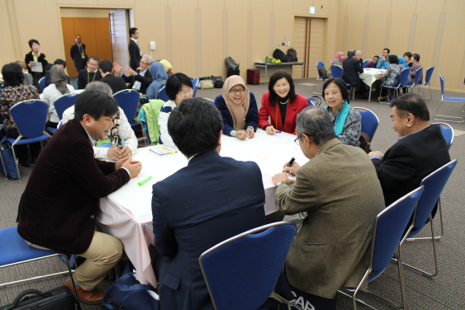
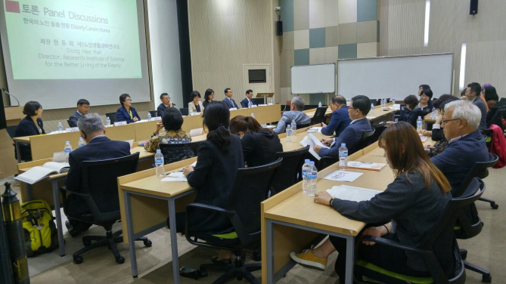
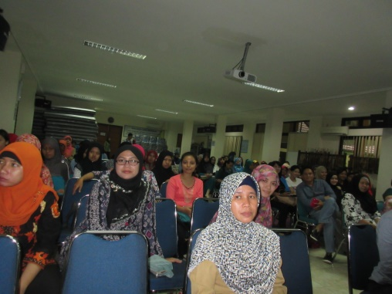
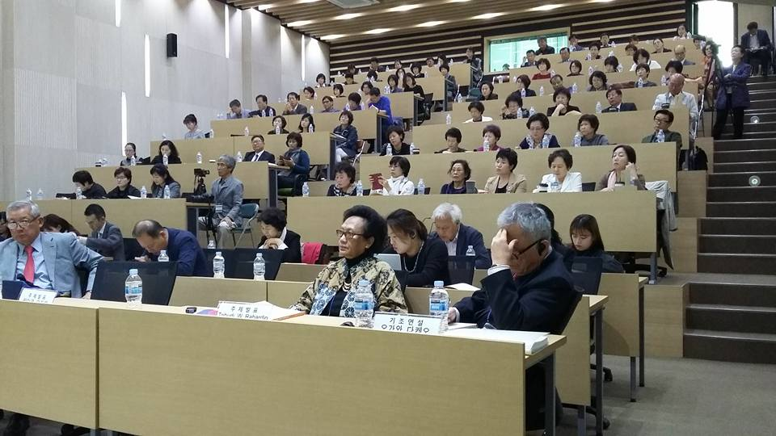
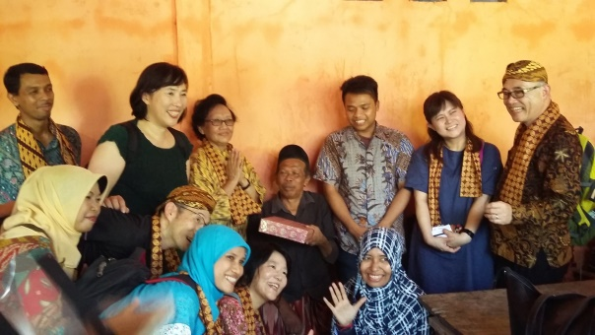
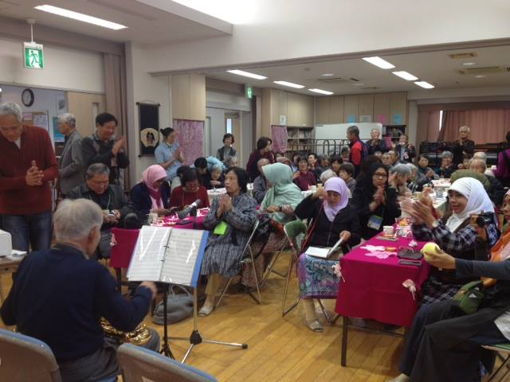
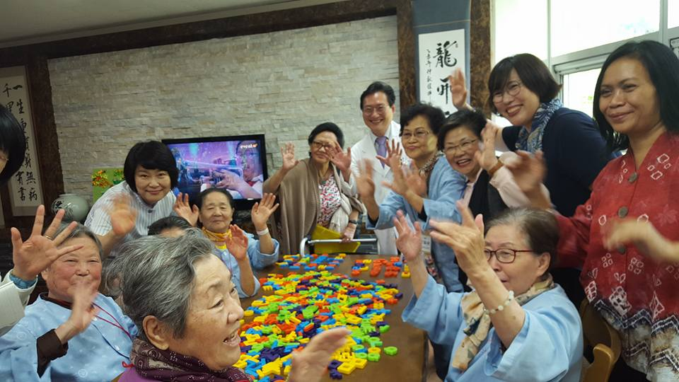
Methodology Mutual Understanding & Cooperation
6-12 Dec. 2015
Jakarta, Yogyakarta, & Solo
17-20 Oct. 2016 Busan
Workshop with NGO, Citizen, Administrator, & Researcher
International Conference with Extended Participants
5-8 March, 2016
Fukuoka
Study Tour of Community Activities
Notes:
In Toyota Foundation project, we tried three methodology for understand with each other countries’ efforts: Workshops, international meetings and study tours.

Slide 8
Result Mutual Understanding of Integrated Community Care for Older Persons
Notes:
Through these methodologies, we have recognized the differences of each community care system through above activities. And we convinced that health and social workers should be re-trained for promoting community care.
For example, Japanese Integrated community care system must be established by each municipality based on their independence and originality in collaboration with private sectors, volunteers and so on. It means professionals should engage in a training of trainers, and training for family care givers and volunteers.
Korean community care system is differentiated still among health care and social work sectors. Also people are still depend on family care givers. On the one hand, If older persons cannot depend on family care givers, they will be hospitalized for medical care reluctantly. On the other hand, Korean long-term care workers are underestimated their competence because long-term care facilities are not preferred by older persons, because of its Stigma. It means ToT program will be required for capacity building of community care.
Every governmental ministry and NGOs are promoting of community care for older persons. On grass-root communities, many family care givers and neighbor are supporting frail older persons. But, Indonesian community care is not systematized yet.
Therefore, we convinced needs to challenge harmonization of each community care for older persons.

Slide 9
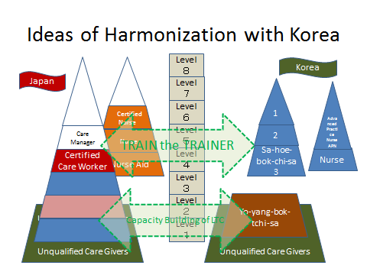
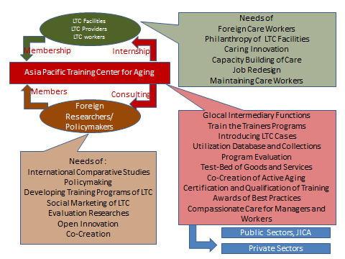
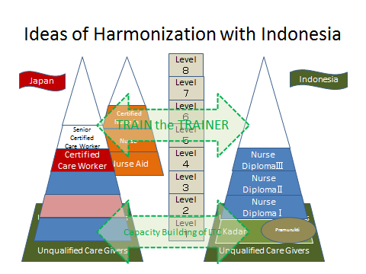
Proposition Establishing International Training Center
Notes:
In order to construct of international standard of qualification framework of job, we will take consideration of European Qualification Framework .
If we think about national training programs under the EQF criteria, we will be able to understand each country’s qualification of Health and Social care workers in Asia. Comparing with each qualification of competency of health and social service, we will be able to find common knowledge and skills internationally. Also we can identify each particularistic training which will be provide by each country.
Therefore, we need to coordinate these situations of each country through establishing an international training center or platform. It will have not only training but also research and development, living lab., and dissemination of aging policies in Asian countries. Then, I have recommended this idea to Fukuoka-city. Japanese national government is also promoting same idea in “Asia Human Well-being Initiative.”
The international ToT program for promoting health and social care for the older persons should be developed in this center.

Slide 10
ASO EDUCATION SERVICE CO.,LTD
Kyungpook National
University
Notes:
After the Toyota Foundation Project, we have started tentative training of entry level long-term care for community care givers in Japan and Indonesia. Also we are discussing with Korean colleagues regarding assessment method for older persons in a community. Furthermore, I will engage in JICA Partnership Program for disseminating preventive long-term care training in Fukuoka-prefecture and Bangkok Metropolitan Administration.
I will appreciating my colleagues: Dr. Lee Sungkook, Emeritus Professor of Kyungpook National University, Dr. Sunwoo Duk, Project Manger of Korean Institute for Health and Social Affairs, Dr. Donghee Han, Director of Research Institute of Science for the Better Living of the Elderly, Dr. Tri Budi Rahardjo,Dr. Susiana Nugraha, and Ms Dinni Agustin, Centre for Ageing Studies, University of Indonesia, Ms Dwi Enda and Ms Fajar Susanti, Cita Sehat foundation, Ms Reiko Ogawa, Associate Professor of Kyushu University, Ms Masako Yokoyama, Kobe Women’s University, Ms Sachiko Managi, Fukuoka-city Council of Social Welfare, and Mr. Mikio Taguchi, Aso Education Service Company.
There is no path in front of us. A path was made behind us. Let’s challenge toward hyper aging society.
Thank you for your attention. KamSahHamnida, Terimakasih and Arigatougozaimasita.

