Slide 1


AGEING SOCIETY AND CHALLENGES IN SINGAPORE
Public Symposium in Seoul
28 February 2017
Presented by Simon-Peter Lum
Notes:
Presentation is based on statistics and information available as well as work experience, observations and discussions with other practitioners
Does not represent agency or government’s views

Slide 2
Ageing in Singapore
Statistics
Approaches to Senior Care in Singapore
Current Landscape of Senior Care in Singapore
Challenges

Slide 3






Statistics: Elderly Population Comparison
Source: World Bank, ASEAN+6, DOS
Notes:
Percentage of elderly population amongst countries present here
2030 projected numbers

Slide 4
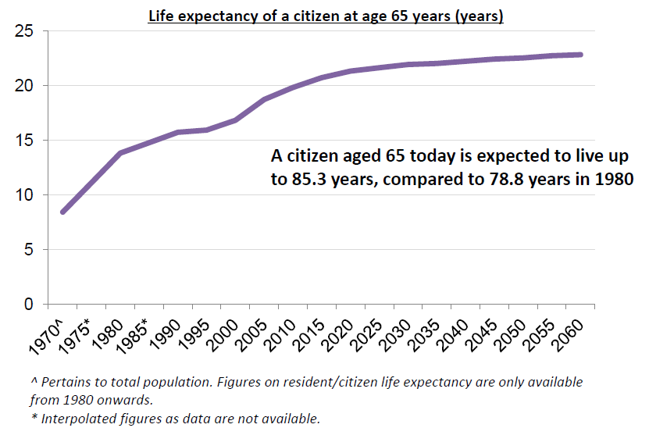
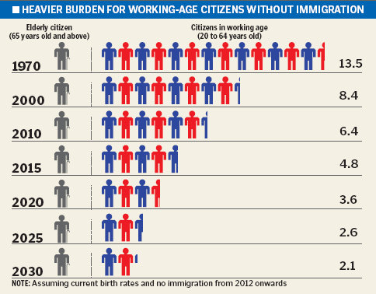
Statistics: Singapore
Source: MOH, DOS
Notes:
Implications
20.3 more years to work and play
Singapore minimum retirement age is 62, reemployment up to age 65, from 1 July 2017, reemployment up to age 67 (Retirement and Reemployment Act (Cap 274A)
Exemptions: Military Officers (age 50), Police, Civil Defence; medical practitioners and dentists; teaching staff of specified tertiary institutions; Administrative Service (Civil Service); pilots and cabin crew
Healthcare (hospitals, community hospitals, nursing homes, community care services), housing (studio apartments, lease buyback, proximity grants), care giving (maids, family members, elderly spouse), income and CPF (minimum sum $83K~$249K and CPF Life)

Slide 5
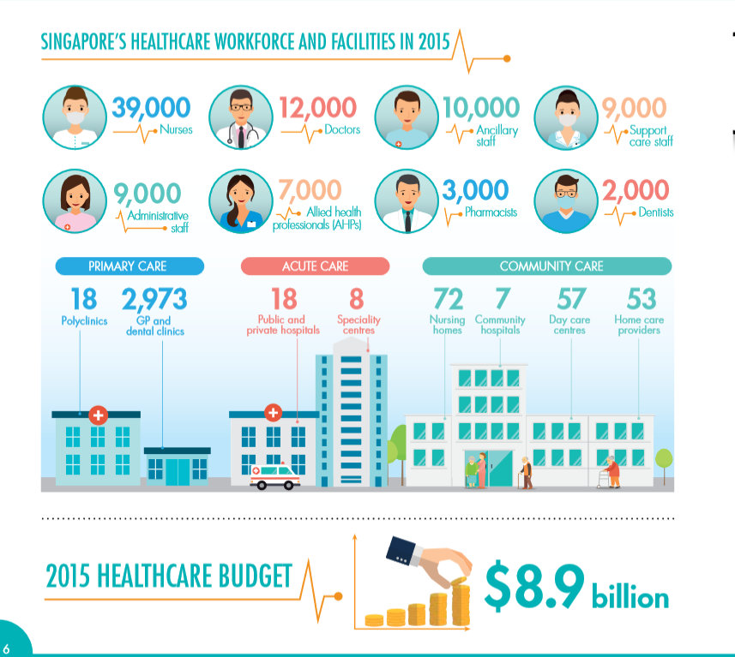

Statistics: Singapore
Source: MOH
Notes:
$8.9 billion (15% of total budget)
Latest: from six regional health systems into three integrated clusters – better co-ordination and integration of care from acute, to primary and community
Raising productivity in view of tightening of labour market (similar to construction industry)

Slide 6
Approaches to Senior Care in Singapore
Family
Government
Private Sector
Voluntary Welfare Organisations
(VWO)
SENIOR
MANY HELPING HANDS
Notes:
Self – own responsibility in one’s well being
Family – immediate and first line of support
Private – when one can afford the services
VWO – when one has difficulty accessing services; support and partnership with private
Government – last option of support, for the most vulnerable: social safety net (destitute people, disabled etc), provide essential services at affordable rates, work with VWO to help the more vulnerable, encourage private sector to chip in charity; ministerial committee on ageing;

Slide 7
Approaches to Senior Care in Singapore
Holistic and Affordable Healthcare and Eldercare
Financial Security
Employment and Employability
Elder-friendly Housing, Transport and Land Use
Active Ageing and Social Integration
Cohesion and Conflict: Inter-Generational Bonding
AGEING IN PLACE
Source: Singapore Civil Service College
Notes:
Financial Security: CPF and CPF Life, COMCARE assistance, rebates and grants
Employment: Retirement and Reemployment Act
Housing, Transport, Land use: Studio apartments, lease buyback, rental housing; senior concession, escalators, lifts and covered walkways; universal design
Active Ageing and Social Integration: Age-in-community, SACs, PGO, PA, Grassroots, C3A
Cohesion and Conflict: inter-generational bonding through activities, volunteering, campaigns
Holistic and Affordable Healthcare and Eldercare: CHAS, PA, Medisave, Medishield (90yo), Subsidies (means tested) – drugs and procedures, community and home care, domestic helper (FDW)

Slide 8


Evolution of Community-Based Senior Care in Singapore
Senior Citizens’ Corner (Grassroots)
Seniors Activity Centre (VWO)
Multi-Service Centres & Neighbourhood Links (VWO)
SAC (Rental) (VWO) / SAC (SA) (Mix)
Day Care / Rehabilitation Centres (Hospitals/VWO)
Senior Care Centres (VWO)
Active Ageing Hubs (VWO)
SPICE (VWO)
Centre-Based Social Care
Centre-Based Medical Care
Notes:
Testing and piloting different models and services
Seeing integration of medical and social care

Slide 9
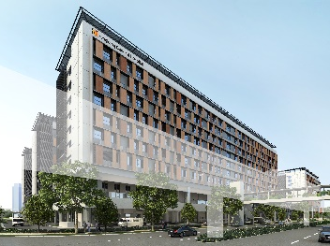
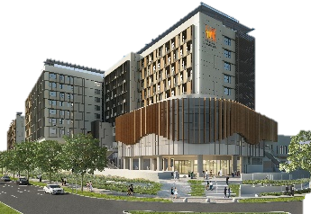
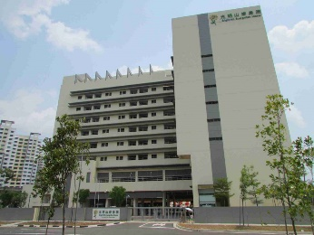
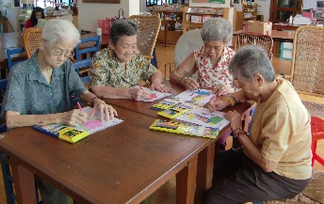
Intermediate and Long Term Care (ILTC)
Senior
Tertiary
(Hospitals)
Intermediate
(Community Hospitals)
Long Term
(Nursing Homes)
Intermediate / Long Term
(Centre-based & Home Care)
Notes:
Hospitals – Doctor, Nurses, Case Manager, Medical Social Workers
Community Hospital / Centre-based / Home Care – Medical, Nursing, Rehabilitation and Personal Care services (dementia care, enhanced dementia care)
Community Based Programmes: CREST (Community Resource, Engagement and Support Team), COMIT (Community Intervention Team)
Testing different models: Senior Group Home, Virtual Hospital, CCMS, Transition Care etc
Nursing Home – Cat III & IV

Slide 10
Summary of Services Provided at Community-Based Care Centres
Services | Seniors Activity Centre | Dedicated Care Centre | Rehab Centre | Home Care | SPICE | Senior Care Centre
Care Needs | Low | Low-Med | Med | Low-High | High | Low-High
Maintenance Day Care | Social Care | Single Service |  |  | √ | √
Day Rehabilitation |  | Single Service | √ |  | √ | √
Dementia Day Care |  | Single Service |  |  | √ | √
Basic Nursing |  |  | √ |  | √ | √
Hospice Day Care |  | Single Service
Medical Escort |  | # | √ |  |  | √
Transport |  | √ | √ | # | √ | √
Meals-on-Wheels |  |  |  | # | # | #
Home Personal Care |  |  |  | √ |  | √
Home Nursing |  |  |  | √ | √ | √
Home Therapy |  |  |  | √ | √ | √
Home Medical |  |  |  | √ | √ | √

Slide 11
Funding for Medical Expenses
Subsidies
(up to 80% government subsidies at public healthcare institutions)
MediSave
(personal CPF for small healthcare bills)
MediShield Life
(personal CPF insurance for larger healthcare bills)
MediFund
(safety net for needy Singaporeans)
Personal
(out-of-pocket & personal insurance)
Notes:
Personal – general GP
Subsidies – hospitalisation
MediSave – inpatient - $450/day; day surgery - $300/day; surgical operations - $250~$7,550; palliative/hospice ($2,500/life), community hospital ($5,000/year), day rehab ($1,500/year); Health screening, chronic diseases management - $400/year; Elderly outpatient treatment - $200/year
MediShield – insurance scheme for B2/C wards; higher payout with private insurers

Slide 12
Funding for Disability
Subsidies
(up to 80%)
Assistance Schemes
(government grants)
ElderShield
(insurance for life)
Personal
(out-of-pocket & personal insurance)
Notes:
Personal –
Subsidies – 80% for home & centre-based care; 75% for nursing homes
Assistance schemes – Interim Disability Assistance Scheme for non-eligible to ElderShield due to age or pre-existing disabilities ($250/month); Seniors’ Mobility and Enabling Fund (subsidies for assistive devices, transport to care services); Foreign Domestic Worker Levy Concession ($60/month levy if FDW is for caring senior); Foreign Domestic Worker Grant ($120/month grant when FDW is hired to care for senior with moderate/severe disabilities); Caregiver’s Training Grant ($200/year for training); Pioneer Disability Assistance Scheme ($100/month for Pioneers with moderate/severe disabilities) – Pioneer born before 31/12/1949 & S’pore Citizen before 31/12/1986)
ElderShield – premium age 40-65, insured for life, $400/month for 72 months (disability – 3 or more ADL)

Slide 13
Integrating Social and Medical Care
Maintenance Day Care
Dementia Day Care
Day Rehabilitation
Basic Nursing
Home Personal Care
Home Nursing
Home Medical
Medical Escort
Transport
Social and Recreational Activities
Community Kitchen
Befriending

Slide 14

Challenges
Funding
Manpower
Coordination and Integration

Slide 15
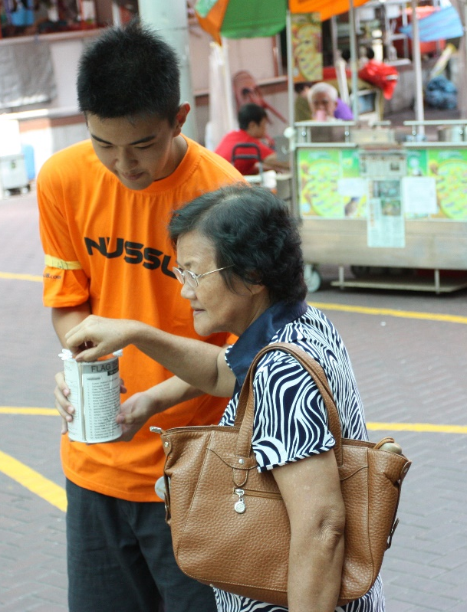
Challenges – Funding
Funding mainly by Government (60 to 100%)
Supplemented by charity dollar (donations and Tote Board)
Limits new (innovative) programmes and services
Competition in fund-raising
Public trust
  http://www.straitstimes.com/opinion/holding-charities-to-account
Notes:
Government funding is conservative and newer programmes are only partially funded or restricted funding (reimbursement, manpower)
Government budget slashed by 2% for most ministries
Hard to get funding for new and innovative programmes and services
Many different charities (more than 2400 registered charities in Arts and Heritage, Community, Education, Health, Religious, Social and Welfare, and Sports)
Scandals and mismanagement (National Kidney Foundation, RenCi, City Harvest, Singapore Association for Visually Handicapped) low of 28% in 2006

Slide 16
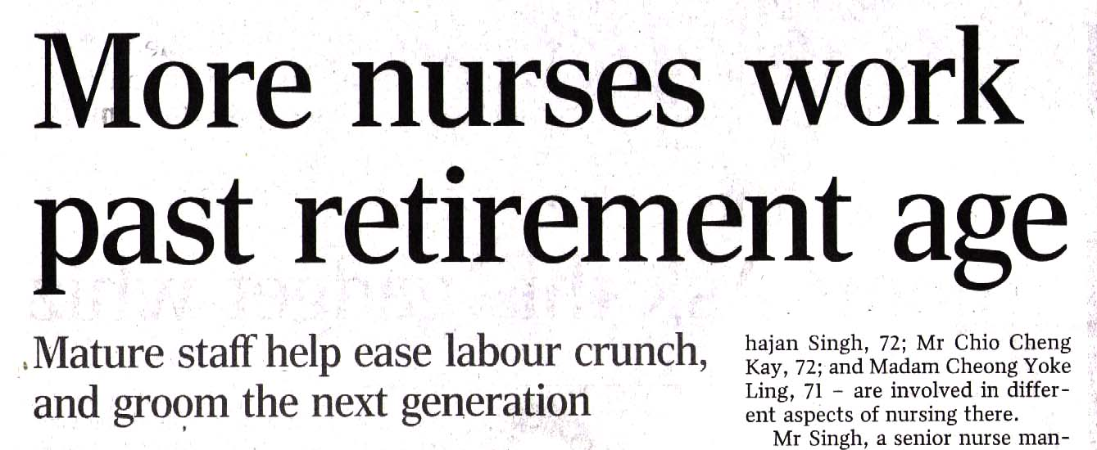
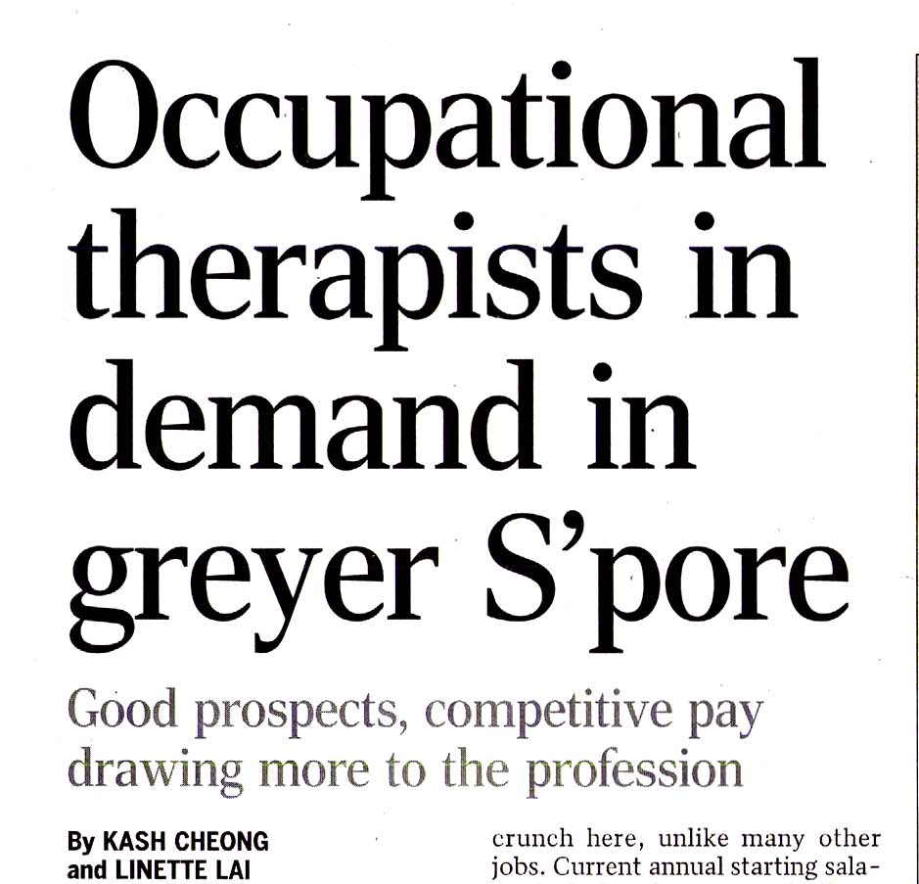
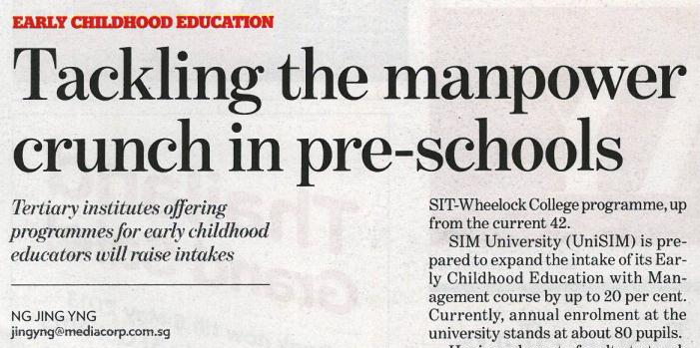

Challenges – Manpower
Manpower limitations (local and foreign)
Language and cultural barriers
Competing with other sectors
Remuneration and benefits
Notes:
Local manpower – unwilling to do care assistant jobs (dirty, physically demanding)
Foreign – levy
Foreign – language and cultural – seniors speak Mandarin, dialects, Malay; cultural insensitivities
Competition for manpower with other sectors, falling birth rate
Pay and benefits lag behind private sector, despite government help and guidelines

Slide 17
Challenges – Coordination & Integration
463 registered members of National Council of Social Service
Many different organisations providing different services
Different organisations providing same services
Competing KPIs and interests
Geographical service boundaries constraints
Coordination and integration of services for clients (case management, data sharing)
Notes:
Too many players, territorial
Central agency (Agency for Integrated Care) but ineffective, just a clearing house, “self-referral”/bureaucratic
Geographical service boundaries – different programmes, different ministries
Medical database, Social Service Net – not integrated, limited access, Personal Data Protection Act, client confidentiality, different SOPs e.g. rental blocks list

Slide 18
Questions?

Slide 19
Thank You

