Slide 1

Population Ageing and Policy Responses in Thailand
Professor Worawet Suwanrada, Ph.D.
Dean, Faculty of Economics, Chulalongkorn University
Public Symposium in Seoul, Korea
Sharing Responses on the Ground – Aging Society and the Surrounding Challenges in Asia
Diamond Hall 2F, Koreana Hotel
February 28, 2017

Slide 2
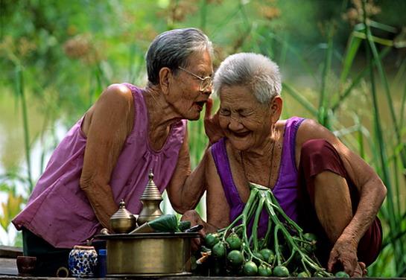
Outline of Presentation
Population Ageing in Thailand
Situation of Older Population in Thailand
Policy Responses
Future Challenges

Slide 3
Outline of Presentation
Population Ageing in Thailand

Slide 4
Population Aging in Thailand
Increase of proportion of older population (aged 60+) through last 50 years.
16.5%
10.78 millions
2015
Source: The National Population and Housing Census, National Statistical Office, quoted in TGRI (2012), The Situation of Thai Elderly 2011.

Slide 5
Population Aging in Thailand
The proportion of the older population aged 60 and over will increase from now 13% (9%)
to 32% (25%) in next three decades. (unit: 1,000)
15.9%
32.1%
66.0%
55.1%
18.1%
12.8%
Source: National Economic and Social Development Board , Population Projection in Thailand: 2010-2040

Slide 6
Population Aging in Thailand The number and proportion of the oldest old population (80 and above) will be increasing. (unit: 1,000)
Thai older persons live longer.
19.1%
37.2%
13.7%
29.6%
43.7%
56.7%
Source: National Economic and Social Development Board (NESDB), Population Projection in Thailand: 2010-2040.

Slide 7
Population Aging in Thailand Continuous Decrease of Potential Support Ratio (Number of the Working Population per One Elderly) from 5 in 2010 to smaller than 2 in 2040
Data Source: National Economic and Social Development Board , Population Projection in Thailand: 2010-2040, calculated by the author.

Slide 8

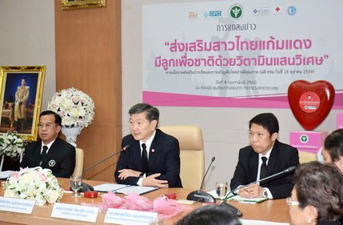
Population Ageing in Thailand:
Fertility Decline (TFR) after 1970s. Thai society has fewer children.
Source: TGRI (2012), The Situation of Thai Elderly 2011 and National Economic and Social Development Board, Population Projection in Thailand: 2010-2040

Slide 9
Outline of Presentation
2.Situation of Older Population in Thailand

Slide 10
Decrease of Mean Number of Living Children by Age of Older Persons
Source: Knodel, Prachuabmoh and Chayovan (2013)’s “The Changing Well-being of Thai Elderly: An update from the 2011 Survey of Older Persons in Thailand”, College of Population Studies, Chulalongkorn University and HelpAge International. For 2014 from John Knodel, Bussarawan Teerawichitchainan, Vipan Prachuabmoh and Wiraporn Pothisiri (2015), The Situation of Thailand’s Older Population: An Update based on the 2014 Survey of Older Persons in Thailand, HelpAge International, Thailand.

Slide 11
Living Arrangements of Older Persons (% older persons aged 60 years and older)
distribution of with whom the live | %
alone | 8.8
spouse only | 19.0
with at least one children | 54.7
other arrangement | 17.5
total | 100
% living with or next door to a child | 65.1
% living with a married child or child in law | 36.9
Location of nearest child | lives alone | lives with spouse only
adjacent | 29.4 | 25.5
same village or municipality | 16.3 | 18.8
same province | 15.4 | 17.6
outside province | 21.5 | 30.1
has no children | 17.5 | 8.0
Total | 100.0 | 100.0
Source: Thailand Gerontology Research Institute’s Situation of Elderly in Thailand 2014.
Source: John Knodel, Bussarawan Teerawichitchainan, Vipan Prachuabmoh and Wiraporn Pothisiri (2015), The Situation of Thailand’s Older Population: An Update based on the 2014 Survey of Older Persons in Thailand, HelpAge International, Thailand.

Slide 12
Old-age Financial Security: Sources and Main Source of Income of Older Population in Thailand (%)
Income Source | Percent receiving any income from the following source |  |  |  |  | Main source of current income
 | 1994 | 2002 | 2007 | 2011 | 2014 | 1944 | 2007 | 2011 | 2014
work | 38.0 | 37.7 | 37.8 | 42.7 | 38.8 | 31.5 | 28.9 | 35.1 | 33.8
pension | 4.1 | 4.3 | 5.4 | 7.5 | 6.3 | 4.0 | 4.4 | 6.0 | 4.8
old age allowance | 0.5 | 3.0 | 24.4 | 81.4 | 84.9 | 0.0 | 2.8 | 11.4 | 14.9
interest, saving, rent | 17.1 | 18.0 | 31.7 | 35.7 | n.a. | 1.7 | 2.9 | 2.6 | 3.8
spouse | 21.4 | 17.4 | 23.3 | 21.4 | 25.2 | 4.6 | 6.1 | 3.1 | 4.3
children | 84.5 | 77.2 | 82.7 | 78.5 | 78.9 | 54.1 | 52.3 | 40.1 | 36.8
relatives | 11.4 | 6.9 | 11.0 | 8.9 | 10.0 | 2.4 | 2.3 | 1.5 | 1.4
other | 8.8 | 2.6 | 1.5 | 2.5 | 1.6 | 1.7 | 0.5 | 0.2 | 0.2
Total | - | - | - | - | - | 100.0 | 100.0 | 100.0 | 100.00
Source: For 1994, 2002, 2007 and 2011 from Table 4.2 in Knodel, Prachuabmoh and Chayovan (2013)’s “The Changing Well-being of Thai Elderly: An update from the 2011 Survey of Older Persons in Thailand”, College of Population Studies, Chulalongkorn University and HelpAge International. For 2014 from John Knodel, Bussarawan Teerawichitchainan, Vipan Prachuabmoh and Wiraporn Pothisiri (2015), The Situation of Thailand’s Older Population: An Update based on the 2014 Survey of Older Persons in Thailand, HelpAge International, Thailand.

Slide 13
Future Generation’s Preparedness
for Old-age Financial Security
Year of Survey | Should we prepare ourselves for old-age life or not? |  |  | The most important issue of preparedness | Adequate Saving/Assets Accumulation for Old-age Life
 |  |  |  |  | Ever thought |  | Never thought
 | Should | Should not | Not sure |  | Prepared | Not Yet
2007 | 91.4 | 3.7 | 4.9 | Finance 98.8 Health 96.9 Housing 96.5 | 57.6 | 32.3 | 10.1
2011 | 87.1 | 6.8 | 6.8 | Finance 98.4 Health 97.3 Housing 97.1 | 53.8 | 33.9 | 12.3
Source: National Survey on Opinions and Attitudes of People on Older Persons in 2007 and 2011 by National Statistical Office

Slide 14

Ability of Daily Livings of Older Persons
%with functional difficulties
%with ADL difficulties
%with IADL difficulties
Source: John Knodel, Bussarawan Teerawichitchainan, Vipan Prachuabmoh and Wiraporn Pothisiri (2015), The Situation of Thailand’s Older Population: An Update based on the 2014 Survey of Older Persons in Thailand, HelpAge International, Thailand.

Slide 15
Main providers of assistance with daily living activities (% of persons 60 and older who have assistance for daily activities)
Source: John Knodel, Bussarawan Teerawichitchainan, Vipan Prachuabmoh and Wiraporn Pothisiri (2015), The Situation of Thailand’s Older Population: An Update based on the 2014 Survey of Older Persons in Thailand, HelpAge International, Thailand.

Slide 16
Outline of Presentation
3.Policy Responses

Slide 17
Policy Responses
Start of the 2nd National Plan on the Elderly (2002-2021)
Proposal for System Reform towards Aging Society by National Reform Assembly
The Act on the Elderly B.E. 2546 (2003 A.D.)
The 1st Evaluation (2002-2006) of
the 2nd NP on the Elderly
The 2nd Evaluation (2007-2011)
The 3rd Evaluation (2012-2016)
2002
2003
2004
2006
2009
2010
2011
2014
2015
2016
Establishment of
Elderly Fund
Universalization of Old-age Allowance
Cabinet Resolution on Ageing Society
Start of Area-based Health Fund Scheme
National Saving Fund Act B.E. 2554
Establishment of National Pension Fund (Provident Fund)
Establishment of National Pension Committee
Subsidization to Private Firms for Older Persons’ Employment
Public Housing for Older Persons
Start of Area-based Health Fund Scheme

Slide 18
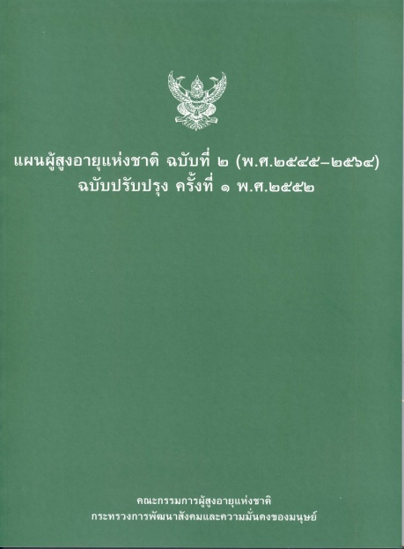

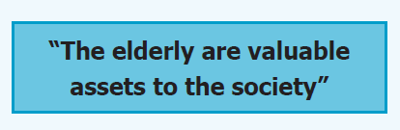
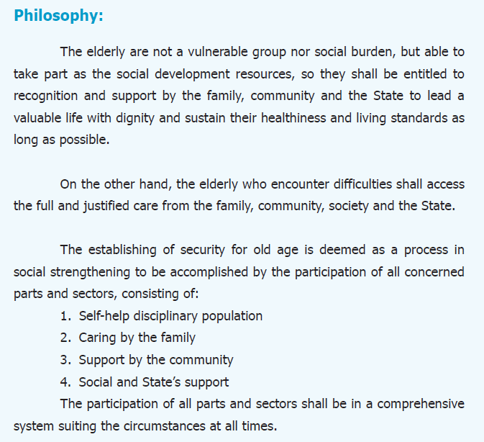
The 2nd National Plan on the Elderly (2002-2021)
Strategy (No. of Index) | Accomplishment (%)
Overall | 51.0%
Strategy on readiness preparation of the people for their quality ageing | 28.6%
Strategy on the elderly promotion and development | 53.3%
Strategy on the social safeguards for the elderly | 33.3%
Strategy on management of developing the national comprehensive system for undertakings and developing the personnel for the elderly involving missions | 85.7%
Strategy on processing, upgrading and disseminating knowledge on the elderly and the national monitoring of implementation of NPE | 100.0%

Slide 19
Public Pension Schemes
Mixed system between occupational (or labor status)-based pension system (for formal sector’s working population, says employees) and Old Age Allowance System
Universal coverage by Old Age Allowance System for the elderly who are not pensioners under occupational-based pension system.
Mixed system
between non-contributory schemes and contributory schemes
Between DB and DC
Fragmented system, managed by many governmental organization
No governmental function to be responsible for entire picture of all public pension schemes.

Slide 20


Entire Picture of Current Public Pension Schemes in Thailand
Formal Sector Working Population
(1/3 of working pop)
Informal Sector Working Population and Non Labor Force Population (2/3 of working pop)
Provident Fund
Government
Pension
Fund
Social Security Fund
Local Government Pension
Fund
Public Enterprises Pension Schemes
National Saving Fund
Government
Pension
Old-age Allowance System

Slide 21
Current Picture of Elderly Care Regime
How to construct proper elderly care system to support medium-income older persons?
Unprivileged Older Person/Household (Low-income)
Medium-income Older Person/Household
High-income Older Persons/Household
Central Government’s Care Facilities/Shelters
Community-based Integrated Older Persons’ Long Term Care System
Institutional Care by Private Care Providers
Local Authorities’ Care Facilities/Shelters
Private Home Helpers
Non-profits Organizations’ Care Facilities/Shelters
Family Care

Slide 22
Community-based Integrated Older Persons’ Long Term Care System

Slide 23
Sub-district Health Fund: started in the beginning of 2006, strengthened 2009, expand to whole country in 2011
To promote community health
To promote well-being of people and community based on the cooperation among citizens, local authorities and public health authorities
To decentralize authority to local authorities under the civic participation and academic support from other organizations.
Tambon Health Fund
National Health Security Office
Tambon Administrative Organization,
Municipality
Community
Community Health Information, Strategy Map, Community Health Plan
Community care for the elderly, the disability, the chronic patients
Preventive care: diabetes, high blood pressure, TB, AIDS
Health behavior adjustment
Cooperation with other relating heath organizations for provision of community health care services

Slide 24
Retirement Age in Thailand
Government Officials: 60 (= pensionable age)
Except for some occupations extended to 65-70
Professional: medical doctor, dentist, veterinarian,
fine artist, traditional dancer, traditional musician, traditional singer
judiciary, judge (until 70)
professor (65)
Private Sector: No mandatory retirement age, normally 55-60
Pensionable age of social security fund’s old-age benefits = 55+

Slide 25
Proposal from National Reform Assembly February 2015
ECON
pension reform
HEALTH
promoting strengthening community-based long term care system, including in urban areas
SOCIAL
promoting preparedness of and empowering individual, family, community, public and private sectors
ENVIRONMENT
economic reform for vitality (especially, labor market)
realizing safe living environment at home and constructing age-friendly communities, promoting social housing and enabling ageing business and industries
increasing older persons’ value

Slide 26
Strategic Plan for Promoting Older Population’s Works
4 Pillars in the Strategic Plan to Cope with Older Workers’ Employment proposed by the Ministry of Labor to the National Older Persons Commission (NOPC)
Promotion of Older Persons’ Employment | Distribution Jobs to Households and Communities | Extension of Official Retirement Age of Government Officials | Promotion of Continuing Employment for Private Sector’s Employees

Slide 27
Cabinet Resolution towards Ageing Society @ November 8, 2016
Subsidization to Older Workers Employment
Employed Older Persons’ Salary and Wages (limits 15,000 THB/month) as Corporate Tax Income Exemption (not more than 10% of total employees)
Senior Complex
Ministry of Social Development and Human Security
National Housing Authority, Government Housing Bank and Community Organizations Development Institute
Reverse Mortgage
Integration of Public Pension Schemes
National Pension Committee
Establishment of National Provident Fund

Slide 28
Outline of Presentation
4.Future Challenges

Slide 29
Future Challenges: How to align all related plans together?
Increasing Thai population’s competency to promote growth adequately | Strengthening Economic Security and Social Protection for Thai population | Promoting well-being of Thai family
(DRAFT) POPULATION PLAN IN 20 YEARS LONG-TERM DEVELOPMENT
(2015-2034)
The 2nd National Plan on the Elderly (2002-2021)
Strategy on readiness preparation of the people for their quality ageing | Strategy the elderly promotion and development | Strategy on the social safeguards for the elderly | Strategy on management of developing the national comprehensive system for undertakings and developing the personnel for the elderly involving missions | Strategy on processing, upgrading and disseminating knowledge on the elderly and the national monitoring of implementation of NPE

Slide 30
Future Challenges
Limitations of Family and Family Support Policy
Roles of Local Authorities in Older Person Affairs
Roles of Private Sector in the Context of Aging Society
Employee Welfare
Promotion of Aging Marketplace (Industry) to enhance Economic Vitality
Financing Aging Society, especially Pension and Long Term Care Issues

Slide 31
Thank you for your attention.
Contact: worawet@gmail.com

